Slide 1
Big data search engine stage 3 Ivan ANikin

Slide 2
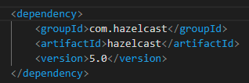
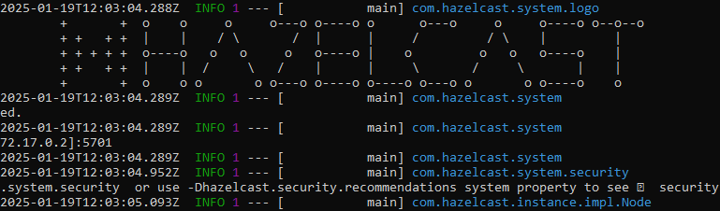
Hazelcast
BookMap
MetadataMap
IndexMap
Crawler
Indexer
Query engine

Slide 3
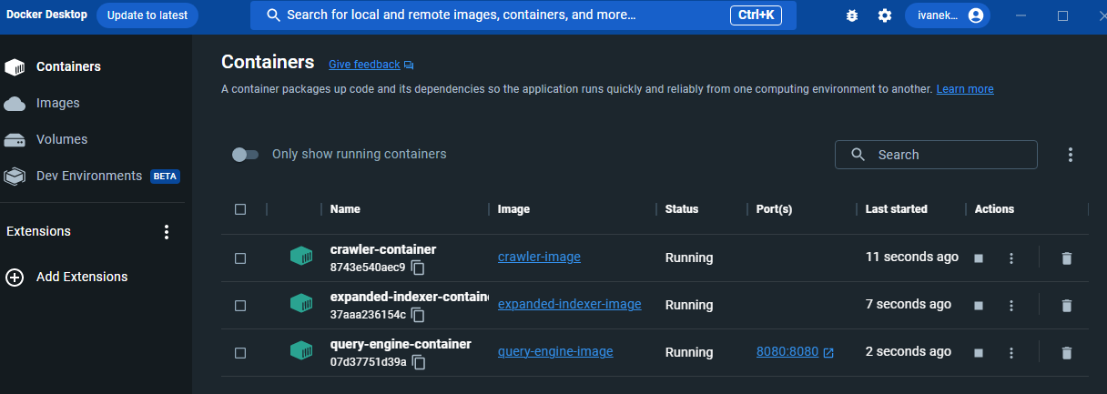
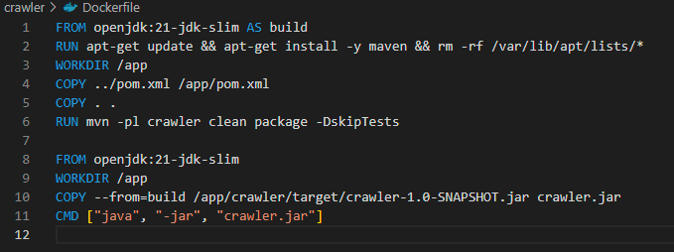
Docker
3 module containers + 1 NGINX container
docker build -f crawler/Dockerfile -t crawler-image .
docker build -f indexer/Dockerfile -t expanded-indexer-image .
docker build -f query-engine/Dockerfile -t query-engine-image .
docker run -it --name query-engine-container -p 8080:8080 query-engine-image

Slide 4

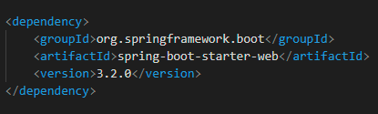
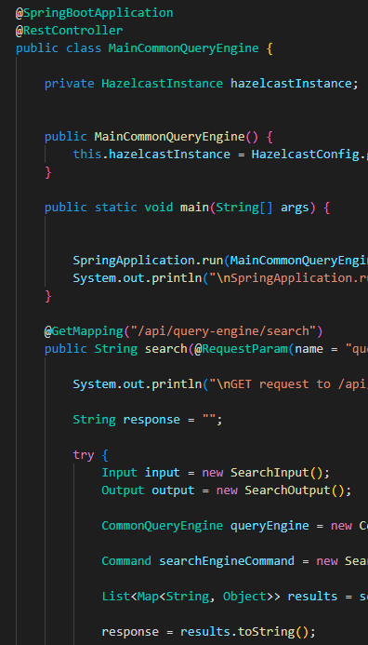
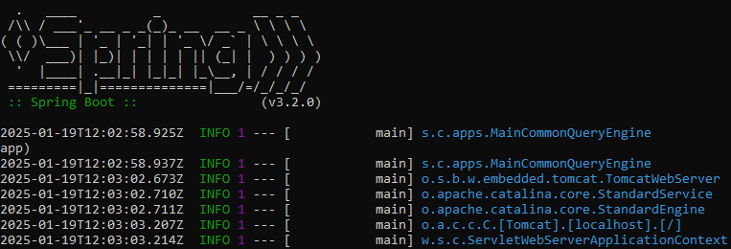
Spring boot
Rest API for Query Engine

Slide 5
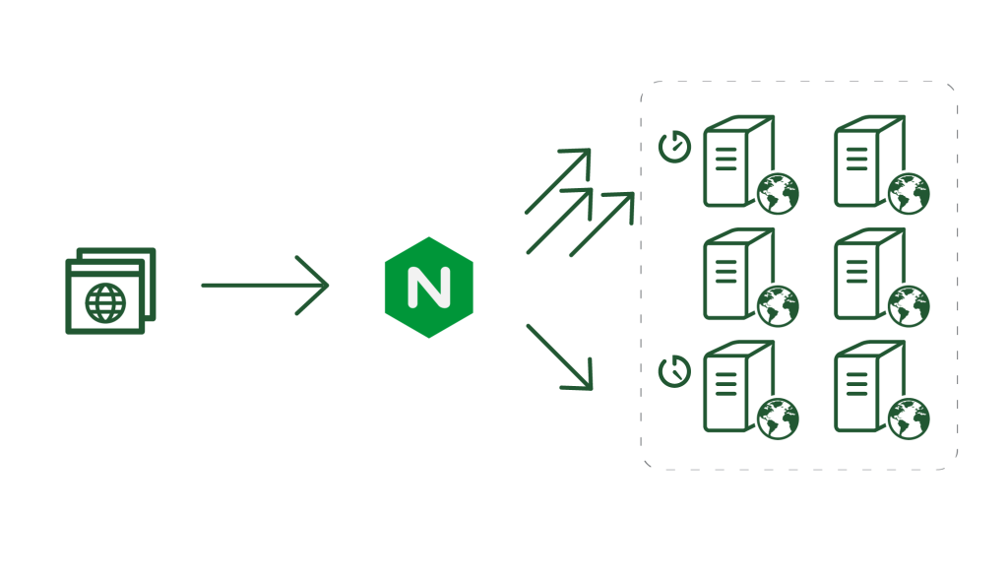
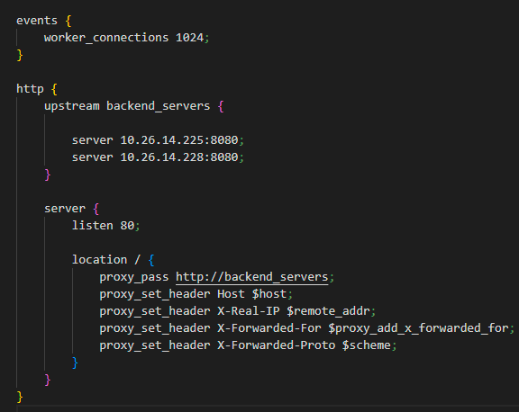
NGINX load balancer

Slide 6
THANK YOU

